Slide 1


Hotel Sales CRM system For National Select Service Hotel Chain
Consulting Firm:
Apoco Designs

Slide 2


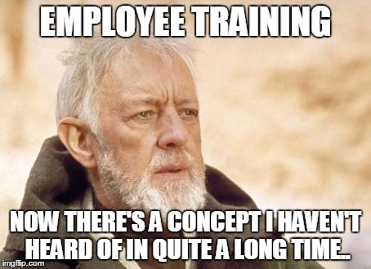

System Objectives
Remove the redundant data entry from the sales process.
Remove the need for paper and electronic file sales system
Improve data consistency by enforcing data type and Requirement rules
Reduce the amount of training required to use the sales system
Improve corporate and LNRs sales by reducing quote times, and standardizing the sales process throughout the brand.

Slide 3
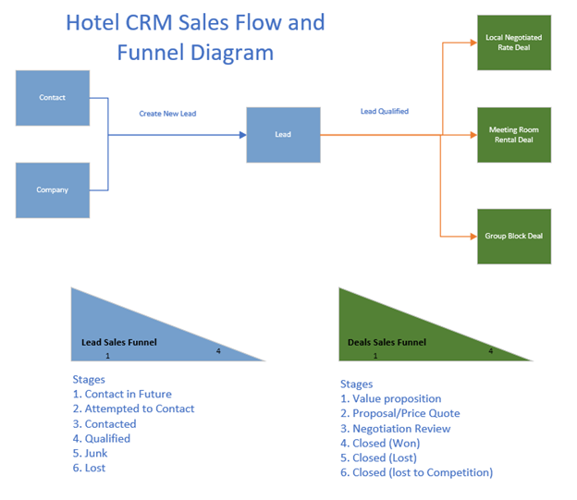
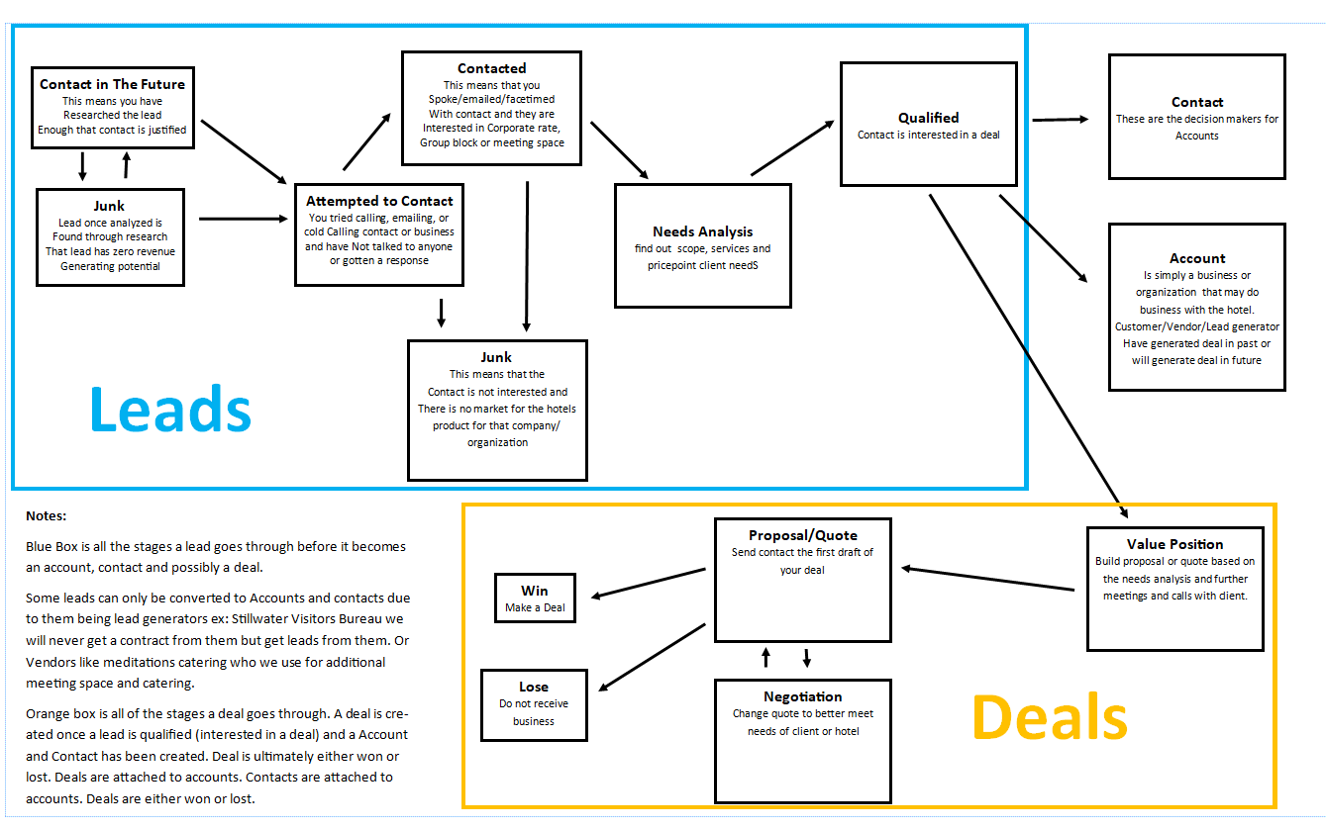
Sales process

Slide 4
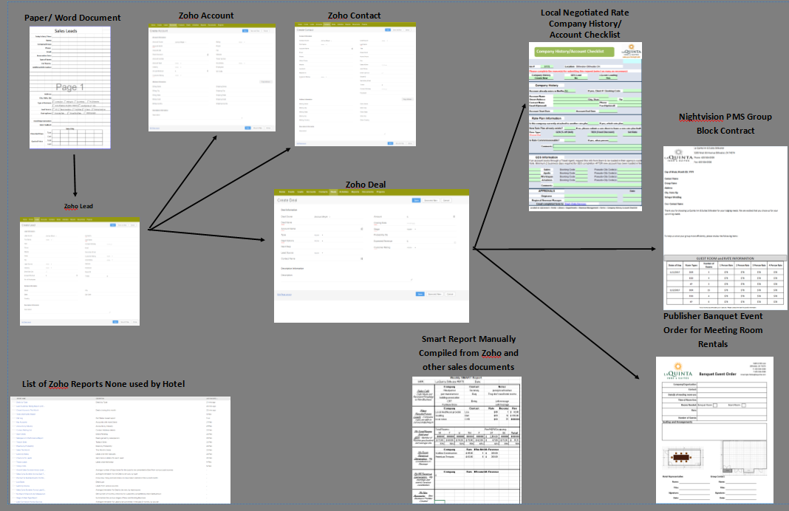

Slide 5
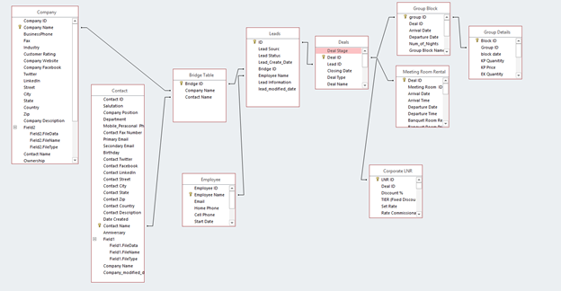
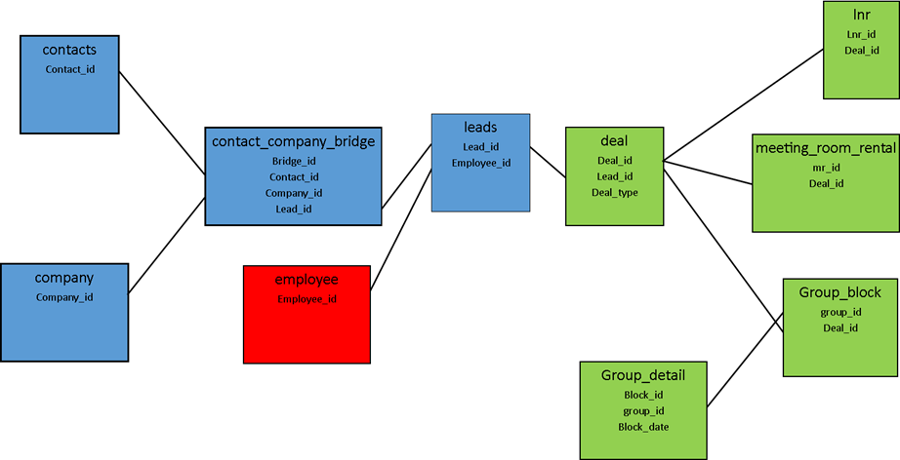
Initial Database Design

Slide 6
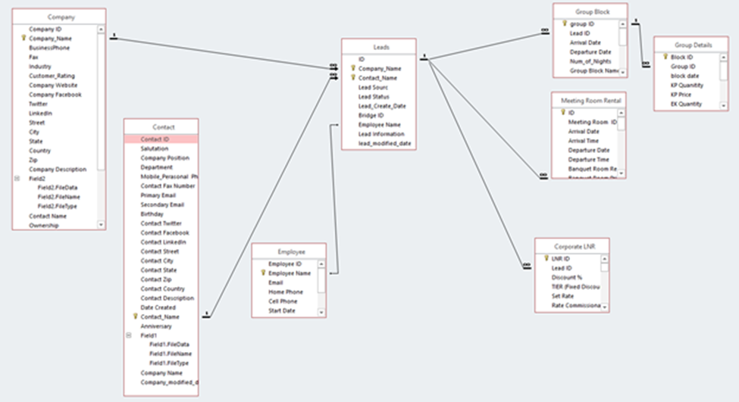
Final Database Design

Slide 7
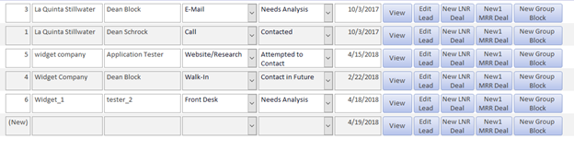


Module Navigation
List Navigation
Form Navigation

Slide 8
Demo

